Slide 1
Laplace Transform Analysis
Linear Circuit Analysis II
EECE 202 – Spring 2025

Slide 2
Announcement
GCA 1 (individual) - Week 5 (Second Lecture)

Slide 3
Recap
Types of Partial Fraction Expansions
Repeated Poles
Applying the Inverse Laplace Transform to the Decomposed Terms
New Material
Solution of Integral-Differential Equations
Time Differentiation
Integration Property
Apply Laplace Transform to given differential or integral equation.

Slide 4
Learning Outcomes
2. an ability to compute responses of linear circuits with and without initial conditions via one-sided Laplace transform techniques. SO [1]

Slide 5
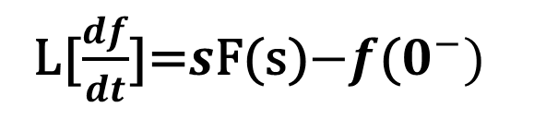
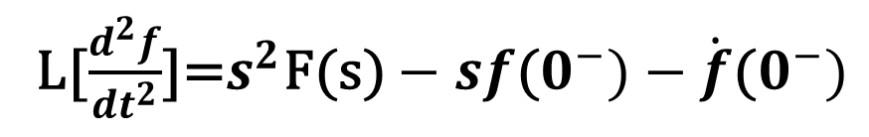
Time Differentiation Property
L[$\frac{df}{dt}$]=$s$F(s)$−f$($0^{−})$
L[$\frac{d^{2}f}{{dt}^{2}}$]=$s^{2}\text{F}\text{(}\text{s}\text{)}−sf\text{(}0^{−})−\dot{f}\text{(}0^{−})$
L[$\frac{d^{n}f}{{dt}^{n}}$]=$s^{n}$×F(s)$−s^{n−1}×f$($0^{−})−s^{n−2}×\dot{f}\text{(}0^{−})−…f^{(n−1)}\text{(}0^{−})$
Differentiation in the time domain is equivalent to multiplication by s in the s-domain.

Slide 6
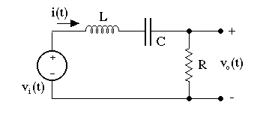
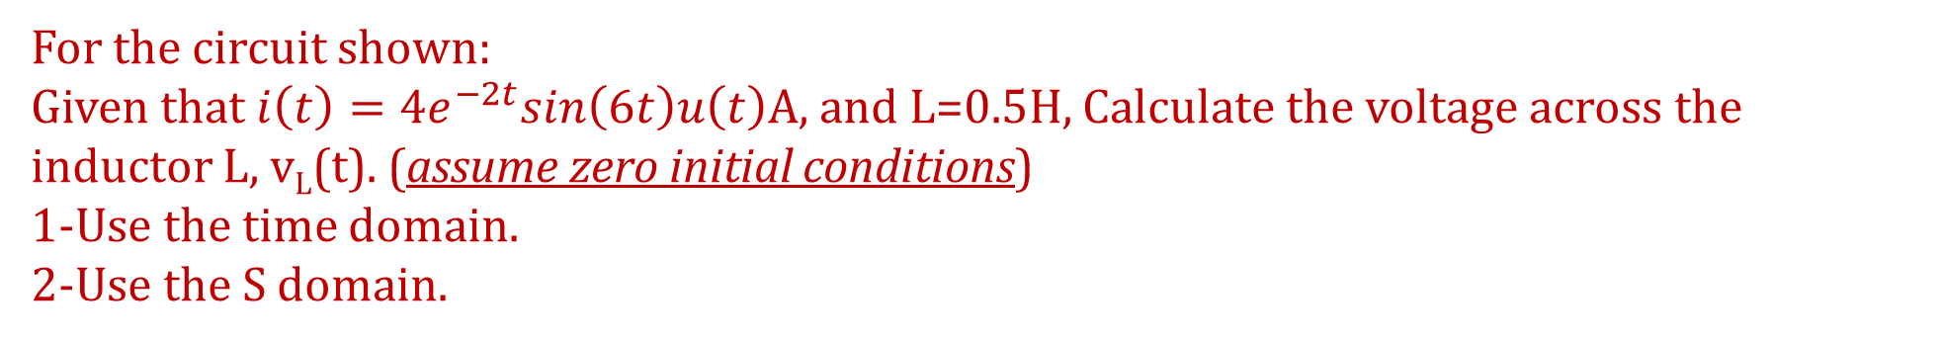
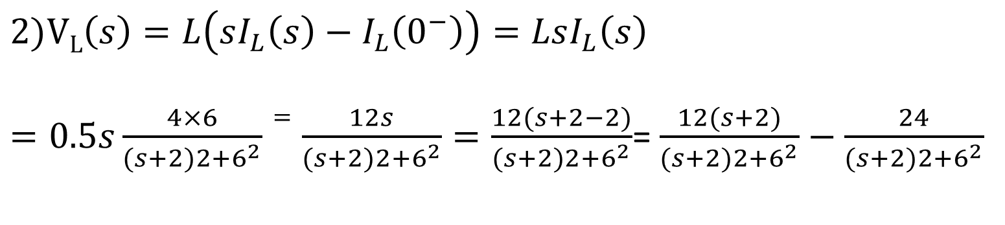

Example 1
For the circuit shown:
Given that $i\left(t\right)=4e^{−2t}sin\left(6t\right)u\left(t\right)A,$ and L=0.5H, Calculate the voltage across the inductor L, v_{L}(t). (assume zero initial conditions)
1-Use the time domain.
2-Use the S domain.
$$1)\text{v}\text{L}\text{(}\text{t}\text{)}=L\frac{di(t)}{dt}$$
$$2)\text{V}\text{L}\left(s\right)=L\left(sI_{L}\left(s\right)−I_{L}\left(0^{−}\right)\right)=LsI_{L}\left(s\right)$$
$=0.5s\frac{4×6}{(s+2)2+6^{2}}=\frac{12s}{(s+2)2+6^{2}}=\frac{12(s+2−2)}{(s+2)2+6^{2}}$= $\frac{12(s+2)}{(s+2)2+6^{2}}−\frac{24}{(s+2)2+6^{2}}$
$$v_{L}\left(t\right)=12e^{−2t}cos\left(6t\right)u\left(t\right)−4e^{−2t}sin\left(6t\right)u\left(t\right) V$$

Slide 7
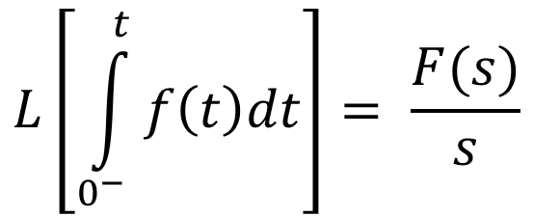
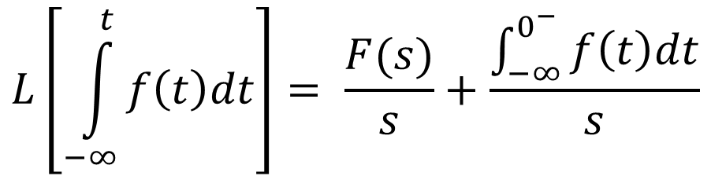
Integration Property
Integration in the time domain is equivalent to division by s in the S-domain
$$L\left[\int_{0^{−}}^{t}{f\left(t\right)dt}\right]= \frac{F(s)}{s}$$
$$L\left[\int_{−∞}^{t}{f\left(t\right)dt}\right]= \frac{F(s)}{s}+\frac{\int_{−∞}^{0^{−}}{f\left(t\right)dt}}{s}$$

Slide 8
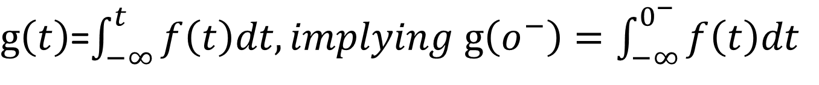
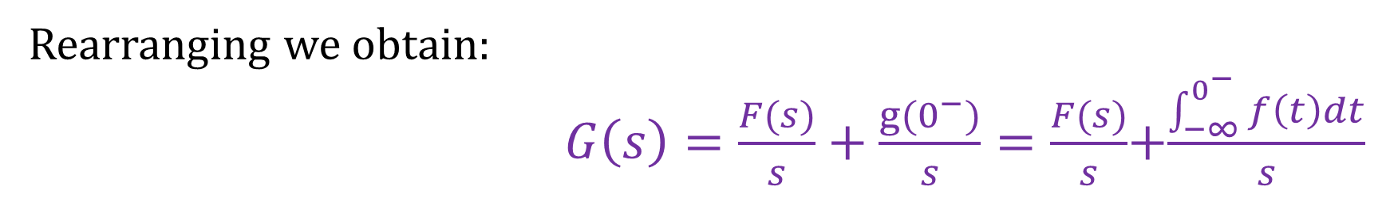
As a result, the common question is: you told us that the Laplace transform does not look at function values for t < 0. And this is true. So how is the question resolved? Actually we are finding the Laplace transform of:
It is also clear that
$g\left(t\right)$=$\int_{−∞}^{t}{f\left(t\right)dt, implying g\left(o^{−}\right)=\int_{−∞}^{0^{−}}{f\left(t\right)dt}}$
Thus $f\left(t\right)= \frac{d}{dt}g\left(t\right), in which case F\left(s\right)=sG(s)$-g($0^{−})$
Rearranging we obtain:
$G\left(s\right)=\frac{F(s)}{s}+\frac{g(0^{−})}{s}=\frac{F(s)}{s}$+$\frac{\int_{−∞}^{0^{−}}{f\left(t\right)dt}}{s}$

Slide 9
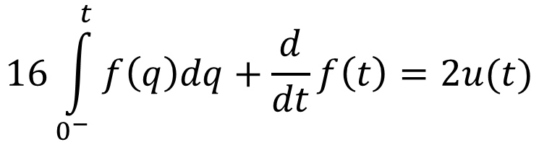
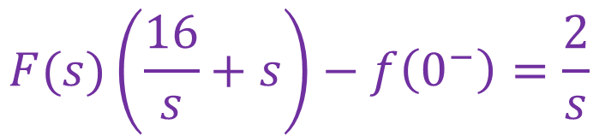
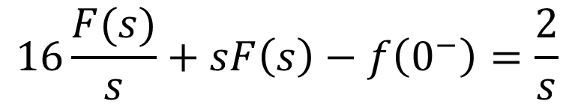
Example 2
Find the solution to the following differential equation
$$16\int_{0^{−}}^{t}{f\left(q\right)dq+\frac{d}{dt}f\left(t\right)=2u(t)}$$
Apply Laplace transform to the given formula
$$16\frac{F(s)}{s}+sF\left(s\right)−f\left(0^{−}\right)=\frac{2}{s}$$
$$F(s)\left(\frac{16}{s}+s\right)−f\left(0^{−}\right)=\frac{2}{s}$$

Slide 10
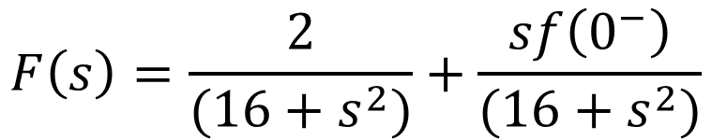
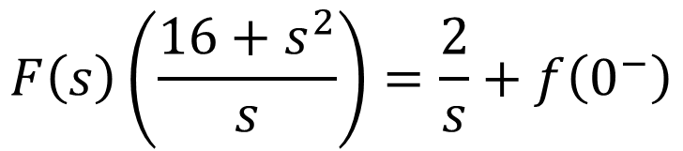
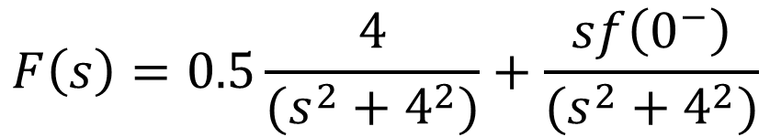
$$F\left(s\right)\left(\frac{16+s^{2}}{s}\right)=\frac{2}{s}+f\left(0^{−}\right)$$
$$F\left(s\right)=\frac{2}{(16+s^{2})}+\frac{sf\left(0^{−}\right)}{(16+s^{2})}$$
$$F\left(s\right)=0.5\frac{4}{(s^{2}+4^{2})}+\frac{sf\left(0^{−}\right)}{(s^{2}+4^{2})}$$
f$\left(t\right)=0.5\sin\left(4t\right)u(t)+f\left(0^{−}\right)\cos\left(4t\right)u(t)$

Slide 11













Example 12.21 (p. 580)
Find the Laplace transform of the signal f(t) sketched in Figure below using the integration property.
$$f\left(t\right)$$
$$g\left(t\right)$$
$$T$$
$$1$$
$$2T$$
$$t$$
$$0$$
$$T$$
$$t$$
$$−1$$
$$0$$
$$T$$
$$2T$$
Note that the triangular waveform f(t) is the integral of the square wave g(t)

Slide 12

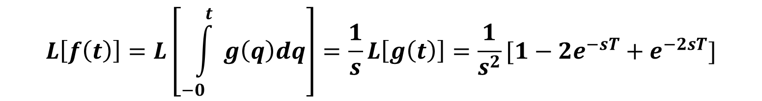
Step 1. Represent the square wave g(t) in terms of steps and shifted steps:
g(t ) = (u(t )- u(t −T))-(u(t −T)- u(t −2T )
= u(t )- 2u(t −T)+ u(t − 2T)
Step 2. Obtain the Laplace transform of g(t)
$$L\left[g\left(t\right)\right]=\frac{1}{s}[1−{2e}^{−sT}+e^{−2sT}]$$
Step 3. Apply the integration property using $f(t) = \int_{{−0}^{}}^{t}{g\left(q\right)dq}$
$$L\left[f\left(t\right)\right]=L\left[\int_{{−0}^{}}^{t}{g\left(q\right)dq}\right]=\frac{1}{s}L\left[g\left(t\right)\right]=\frac{1}{s^{2}}[1−{2e}^{−sT}+e^{−2sT}]$$

Slide 13
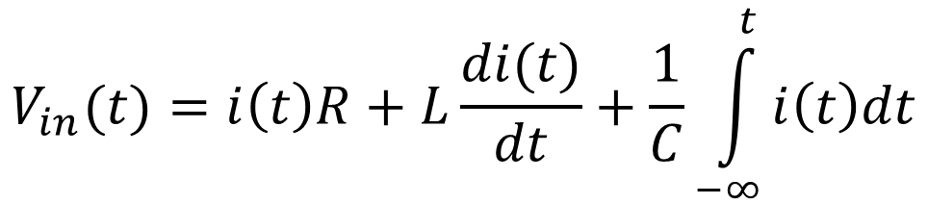

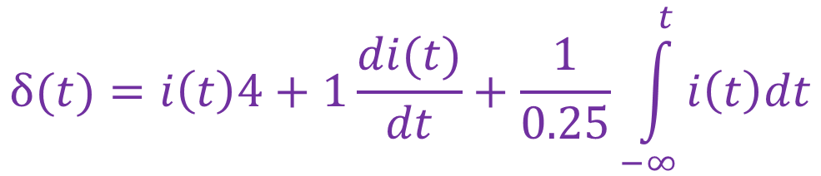
Example 12.26 (p. 587)
Find the current (i(t)) flowing in the circuit below,
given that: V_{in} (t)= δ(t), i_{L}(0⁻) = 1A, V_{C}(0⁻)= -2 V
+ V_{R} -
+ V_{L} -
4 Ω
1 H
$$V_{in}=V_{R}+V_{L}+V_{C}$$
+
+
V_{in} (t)
i(t)
V_{C}
-
$$V_{in}(t)=i\left(t\right)R+L\frac{di(t)}{dt}+\frac{1}{C}\int_{−∞}^{t}{i\left(t\right)dt}$$
0.25 F
-
$$δ(t)=i\left(t\right)4+1\frac{di(t)}{dt}+\frac{1}{0.25}\int_{−∞}^{t}{i\left(t\right)dt}$$
Since V_{in} (t)= δ(t)

Slide 14
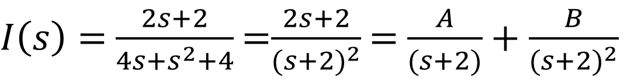
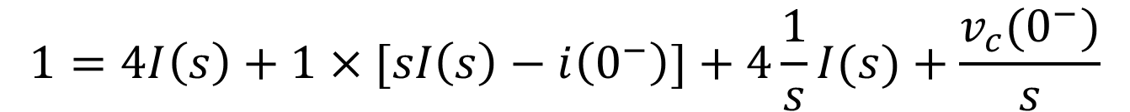


By applying LT to the obtained equation
$$1=4I\left(s\right)+1×[sI\left(s\right)−i\left(0^{−}\right)]+4\frac{1}{s}I(s)+\frac{v_{c}(0^{−})}{s}$$
$$1+1+\frac{2}{s}=I\left(s\right)[4+s+4\frac{1}{s}]$$
$$\frac{2S+2}{s}=I\left(s\right)[\frac{4s+s^{2}+4}{s}]$$
Solve for I(s)
$I\left(s\right)=$ $\frac{2s+2}{4s+s^{2}+4}$ =$\frac{2s+2}{{(s+2)}^{2}}$ = $\frac{A}{(s+2)}+\frac{B}{{(s+2)}^{2}}$
B=-2, A= 2
Apply inverse LT to get i(t)
$$i\left(t\right)=2e^{−2t}u\left(t\right)−2e^{−2t}r\left(t\right) A$$

Slide 15
How does differentiation in the time domain translate to the s-domain using the Laplace transform?
Explain how the integration property of Laplace transforms is used to simplify solving circuits with capacitors and inductors.
After solving an equation in the s-domain, what is the process of using the inverse Laplace transform to find the time-domain solution?
Why is the Laplace transform particularly useful for handling initial conditions in circuits? Give an example of how it simplifies solving a differential equation.
Solve activity on Moodle
Practice – Use AI and answer

Slide 16
Summary
Time Differentiation Property
Differentiation in time domain = Multiplication by s in the s-domain.
Integration Property:
Integration in time domain = Division by s in the s-domain.
Steps to Solve Differential Equations:
Apply the Laplace transform to both sides of the equation.
Solve for the unknown function in the s-domain (e.g., F(s)F(s)F(s)).
Apply the inverse Laplace transform to obtain the solution in the time domain.
Suggested Additional Problems for Ch. 12:
Example 12.27 (p. 588), Exercise (p. 588) ???

